Slide 1
Project Presentation:
Text Summarization Using Natural Language Processing.
CSCI 4342 NATURAL LANGUAGE PROCESSING
SEMESTER 1, 2020/2021
LECTURER: DR. SURIANI BT. SULAIMAN

Slide 2
Presented by:
Islam MD Shariful
1720601
Abdella Mame Abdo
1714883
Mohamed Moubarak Mohamed 1820705

Slide 3
Introduction
Text summarization is the process of shortening a text document with software, in order to create a summary with the major points of the original document.
The target of text summarization is shorten the source text into a diminished version conserving its information content and overall meaning.
Text summarization methods:
Abstractive Summarization is describing the content of the text with heavy NLP.
Extractive Summarization is a method for determining salient text by looking at the text unit’s lexical and statistical relevance or by matching phrasal patterns.
Text summarization groups:
Indicative summarization gives the main idea of the text to the user.
Informative summarization system gives brief information of the main text.

Slide 4
Technical Background
NLTK
platform for building Python programs to work with human language data.
Tf-Idf
Tf-Idf is an approach to measure single text terms. It refers to “term frequency–inverse document frequency”, that is used to to score the importance of a word in a document based on how often it appears in that document and a given collection of documents.
Position of sentence
Sentence position is defined by the ordinal position of sentences.

Slide 5
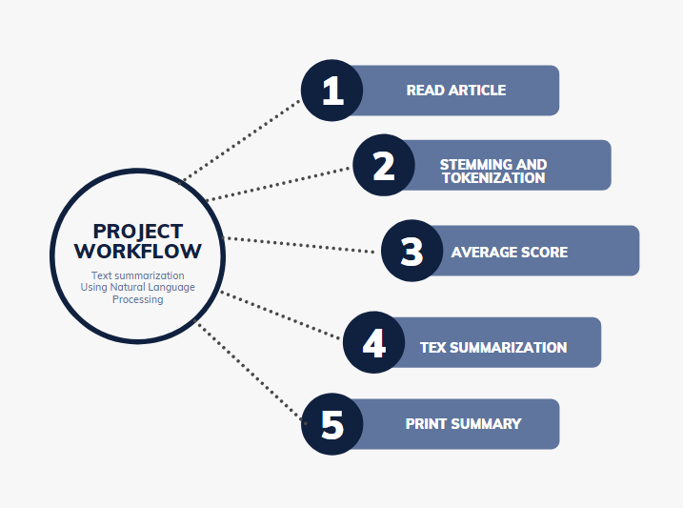
Methodology

Slide 6
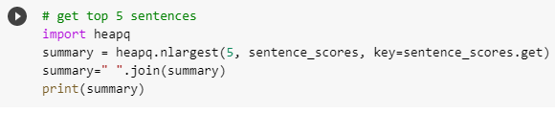
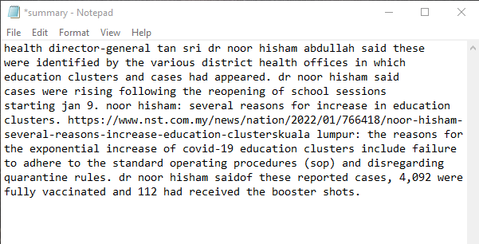
Result
Summarization
sentence_scores
'a 313 per…… . .': 1.8461538461538463,
'During the..… . ': 1.7692307692307692,
' "the majority… .': 2.46153846153846,
' "the remaining ….…': 2.4615384615384,
'dr noor ………….': 3.8461538461538476,
'dr noor……….….': 3.6153846153846168,
'he revealed….….': 3.3076923076923075,
'Health director……': 6.384615384615385,
'however, the…….': 1.5384615384615383,
'on the 4th..…….….': 3.230769230769231,
'other proposals ….': 1.923076923076923

Slide 7
Conclusion
Automatic Text Summarization is a prominent challenge in machine learning and natural language processing in which a computer programme shortens lengthy texts and provides summaries in order to deliver the intended information. Summaries shorten reading time when studying materials, summaries make the selecting process easier. Indexing becomes more effective with automatic summarization. Automatic summarizing systems are less prejudiced than human summarizers. However, automated summarizing takes less time to complete than human summarizers.

Slide 8
Thank you

